Slide 1
Outline
Part 0: HL7 RIM
Part 1: Survey of GO and its problems
Part 2: Extending GO to make a full ontology
Part 3: Conclusion

Slide 2
The Gene Ontology
Barry Smith

Slide 3
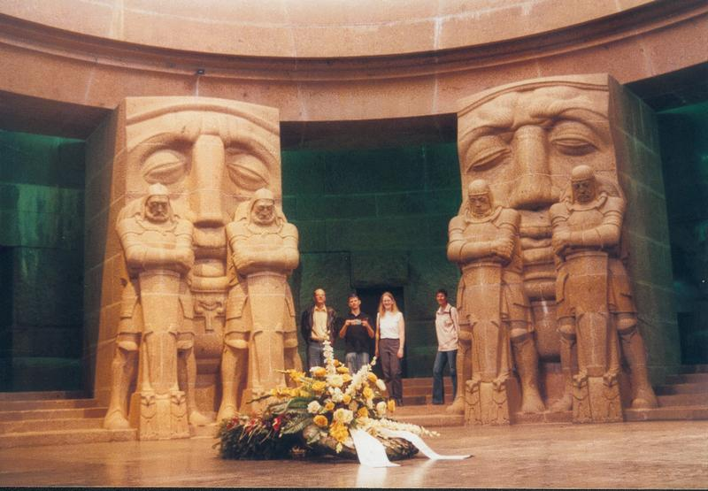
Part Zero
Preamble on
HL7-RIM

Slide 4


Slide 5
HL7 RIM
(Health Level 7 Reference Information Model) a set of standards for exchange, integration, sharing, and retrieval of electronic health information that supports clinical practice

Slide 6
… based on Speech Act Theory
the medical record is not a collection of facts, but "a faithful record of what clinicians have heard, seen, thought, and done" [based on] what is known as "speech-acts" in linguistics and philosophy.
Notes:
http://www.hl7.org/library/data-model/RIM/C30122/rim.htm#Act-cls

Slide 7
The Ontology of HL7 RIM
Act as statements or speech-acts are the only representation of real world facts or processes in the HL7 RIM. The truth about the real world is constructed through a combination (and arbitration) of such attributed statements only, and there is no class in the RIM whose objects represent "objective states of affairs" or "real processes" independent from attributed statements.
As such, there is no distinction between an activity and its documentation. Every Act includes both to varying degrees.

Slide 8
Why is this important?
in the world of HL7 “there is no distinction between an activity and its documentation”
(Il n’ya pas de hors-texte …)

Slide 9
HL7 Corporate Sponsors:
GE
IBM
Microsoft
Oracle
Siemens
Sun Microsystems
Ernst & Young
Eli Lilly etc. etc.

Slide 10
HL7 International Affiliates
HL7 Argentina HL7 Australia HL7 Brazil HL7 Canada HL7 China HL7 Croatia HL7 Czech Republic HL7 Denmark HL7 Finland HL7 Germany HL7 Greece | HL7 India HL7 Japan HL7 Korea HL7 Lithuania HL7 Mexico HL7 New Zealand HL7 Southern Africa HL7 Switzerland HL7 Taiwan HL7 The Netherlands HL7 UK Ltd.

Slide 11


HL7 Merchandizing

Slide 12
Federally mandated ontological confusion
“All US federal agencies are required to adopt HL7 messaging standards to ensure that each federal agency can share information that will improve coordinated care for patients”

Slide 13
déformation professionelle of linguists:
= failure to pay due heed to the distinction between facts and their representations
is slowly being imported into biomedical research through the increasing importance of computers

Slide 14
From Medicine
to Biomedicine

Slide 15
Complexity of biological structures
About 30,000 genes in a human
Probably 100-200,000 proteins
Individual variation in most genes
100s of cell types
100,000s of disease types
1,000,000s of biochemical pathways (including disease pathways)

Slide 16
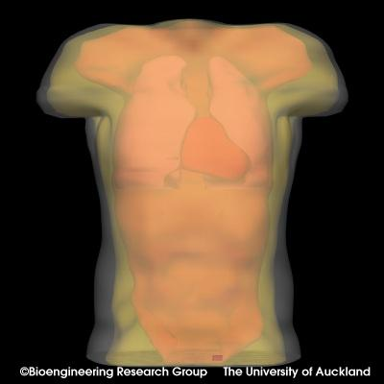

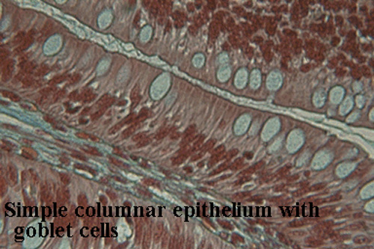
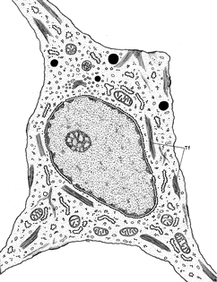
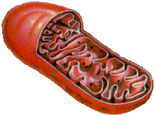
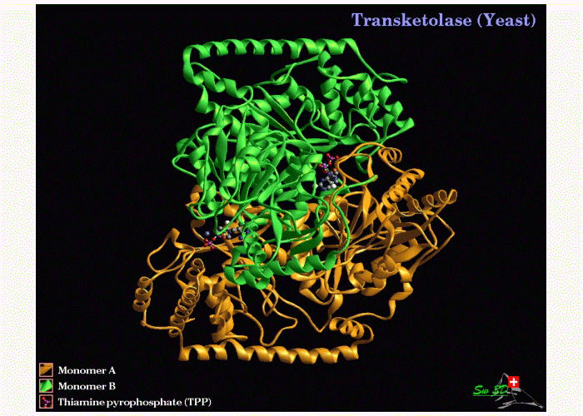
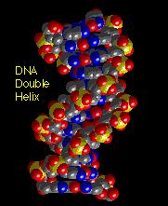
Scales of anatomy
Organism
Organ
Tissue
10⁻¹ m
Cell
Organelle
10⁻⁵ m
Protein
DNA
10⁻⁹ m

Slide 17
The Challenge
Each (clinical, pathological, genetic, proteomic, pharmacological …) information system uses its own terminology and category system
biomedical research demands the ability to navigate through all such information systems
How can we overcome the incompatibilities which become apparent when data from distinct sources is combined?

Slide 18
Answer:
“The Gene Ontology”

Slide 19
Like HL7
an example of a controlled vocabulary = effort at syntactic regimentation

Slide 20
Part One
Survey of GO

Slide 21
GO is three large telephone directories
of terms used in annotating genes and gene products
‘annotating’ = indexing
proximate goal: to standardize reporting of biological results
ultimate goal: to unify biology / bio-informatics

Slide 22
GO an impressive achievement
used by over 20 genome database and many other groups in academia and industry
methodology much imitated
now part of OBO (open biological ontologies) consortium

Slide 23
GO here used as an example
of the sorts of problems faced by current biomedical informatics
of the degree to which philosophy and logic are relevant to the solution of these problems

Slide 24
GO is three ‘ontologies’
cellular components
molecular functions
biological processes
December 16, 2003:
1372 component terms
7271 function terms
8069 process terms

Slide 25
Michael Ashburner:
GO’s philosophy from the beginning was ‘just in time’ - that is, we made no great attempt to ‘complete’ the ontologies …. If you try and ‘complete’ an ontology, or worse: try and ‘get it right,’ then you will fail …

Slide 26
GO built by biologists
Gene “Ontology”
Gene “Statistic”

Slide 27
When a gene is identified
three important types of questions need to be addressed:
1. Where is it located in the cell?
2. What functions does it have on the molecular level?
3. To what biological processes do these functions contribute?

Slide 28
GO’s three ontologies
molecular functions
biological processes
cellular components

Slide 29
GO confined
to what annotations can be associated with genes and gene products (proteins …)

Slide 30
The Cellular Component Ontology (counterpart of anatomy)
flagellum
chromosome
membrane
cell wall
nucleus

Slide 31
The Cellular Component Ontology (counterpart of anatomy)
“Generally, a gene product is located in or is a subcomponent of a particular cellular component.”
Cellular components are independent continuants (= they endure through time while undergoing changes of various sorts)

Slide 32
The Molecular Function Ontology
ice nucleation
protein stabilization
kinase activity
binding
The Molecular Function ontology is (roughly) an ontology of actions on the molecular level of granularity

Slide 33
Scales of anatomy
Organism
Organ
Tissue
10⁻¹ m
Cell
Organelle
10⁻⁵ m
Protein
DNA
10⁻⁹ m

Slide 34
Molecular Function
Definition:
An activity or task performed by a gene product. It often corresponds to something (such as a catalytic activity) that can be measured in vitro.
GO confuses function with functioning
(no room for functions which are not expressed)

Slide 35
Biological Process Ontology
Examples:
glycolysis
death
adult walking behavior
response to blue light
= occurrents on the level of granularity of organs and whole organisms

Slide 36
Biological Process
Definition:
A biological process is a biological goal that requires more than one function. Mutant phenotypes often reflect disruptions in biological processes.

Slide 37
Each of GO’s ontologies
is organized in a graph-theoretical structure involving two sorts of links or edges:
is-a (= is a subtype of )
(copulation is-a biological process)
part-of
(cell wall part-of cell)

Slide 38
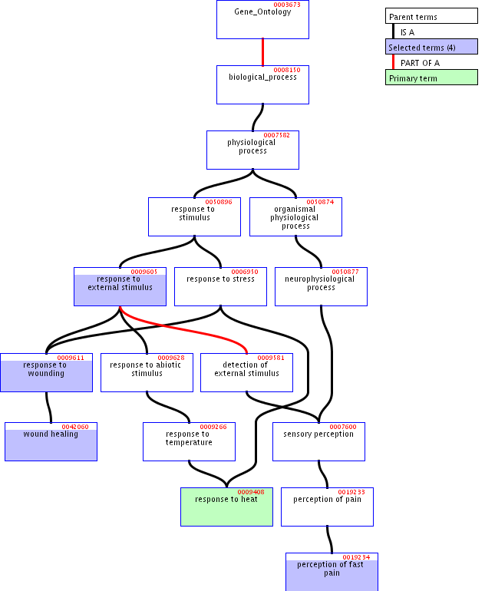

Slide 41
Primary aim
  not rigorous definition and principled classification
  but rather: to provide a practically useful framework for keeping track of the biological annotations that are applied to gene products

Slide 42
GO’s graph-theoretic architecture
designed to help human annotators to locate the designated terms for the features associated with specific genes

Slide 43
GO is a
‘controlled vocabulary’
designed to ensure that the same terms are used by different research groups with the same meanings

Slide 44
Principle of Univocity
terms should have the same meanings (and thus point to the same referents) on every occasion of use

Slide 45
Principle of Compositionality
The meanings of compound terms should be determined
1. by the meanings of component terms
together with
2. the rules governing syntax

Slide 46
The story of ‘/’

Slide 47
/
GO:0008608 microtubule/kinetochore interaction
=df Physical interaction between microtubules and chromatin via proteins making up the kinetochore complex

Slide 48
/
GO:0001539 ciliary/flagellar motility
=df Locomotion due to movement of cilia or flagella.

Slide 49
/
GO:0045798 negative regulation of chromatin assembly/disassembly
=df Any process that stops, prevents or reduces the rate of chromatin assembly and/or disassembly

Slide 50
/
GO:0000082 G1/S transition of mitotic cell cycle
=df Progression from G1 phase to S phase of the standard mitotic cell cycle.

Slide 51
/
GO:0001559 interpretation of nuclear/cytoplasmic to regulate cell growth
=df The process where the size of the nucleus with respect to its cytoplasm signals the cell to grow or stop growing.

Slide 52
/
GO:0015539 hexuronate (glucuronate/galacturonate) porter activity
=df Catalysis of the reaction: hexuronate(out) + cation(out) = hexuronate(in) + cation(in)

Slide 53
comma
lactose, galactose: hydrogen symporter activity
male courtship behavior (sensu Insecta), wing vibration

Slide 54
Principle of Positivity
Class names should be positive. Logical complements of classes are not themselves classes.
(Terms such as ‘non-mammal’ or ‘non-membrane’ or ‘invertebrate’ or do not designate natural kinds.)

Slide 55
Problems with negation
GO has no way to express ‘not’ and no way to express ‘is localized at’)
Holliday junction helicase complex
is-a
unlocalized

Slide 56
GO:0008372 cellular component unknown cellular component unknown is-a cellular component

Slide 57
obsolete molecular function is_a molecular function
obsolete molecular function (obsolete)

Slide 58
Principle of Objectivity
which classes exist is not a function of our biological knowledge.
(Terms such as ‘unclassified’ or ‘unknown ligand’ or ‘not otherwise classified as peptides’ do not designate biological natural kinds, and nor do they designate differentia of biological natural kinds)

Slide 59
Rabbit and copulation both designate natural kinds, but terms such as
rabbit and copulation
rabbit or copulation
do not
Cf. Lewis-Armstrong sparse theory of universals

Slide 60
Principle of Sparseness
Which biological classes exist is not a matter of logic. (Biological combination is not reflected in a Boolean algebra)

Slide 61
oxidoreductase activity,
acting on paired donors,
with incorporation or reduction of molecular oxygen, 2-oxoglutarate as one donor,
and incorporation of one atom each of oxygen into both donors

Slide 62
Is biological classification Linnaean?

Slide 63
1. Principle of Single Inheritance
no class in a classificatory hierarchy should have more than one parent on the immediate higher level
no diamonds:

Slide 64
Principle of Taxonomic Levels

Slide 65
2. Principle of Taxonomic Levels
the terms in a classificatory hierarchy should be divided into predetermined levels (analogous to the levels of kingdom, phylum, class, order, etc., in traditional biology).
‘depth’ in GO’s hierarchies not determinate because of multiple inheritance

Slide 66
Principle of Exhaustiveness
the classes on any given level should exhaust the domain of the classificatory hierarchy.

Slide 67
Single Inheritance + Exhaustiveness = JEPD
Exhaustiveness often difficult to satisfy in the realm of biological phenomena; but its acceptance as an ideal is presupposed as a goal by every scientist.
Single inheritance accepted in all traditional (species-genus) classifications, now under threat because multiple inheritance is a computationally useful device

Slide 68
Problems with multiple inheritance
B C
is-a₁ is-a₂
A E
D
is_a is no longer determinate

Slide 69
‘is-a’ is pressed into service to mean a variety of different things
the resulting ambiguities make the rules for correct coding difficult to communicate to human curators
they also serve as obstacles to integration with neighboring ontologies

Slide 70
is-a
GO’s definition:
A is-a B =def every instance of A is an instance of B
= standard definition of computer science
(confusion of ‘class [natural kind]’ with ‘set’; failure to take time seriously)
adult is-a child

Slide 71
correct reading of is-a
A and B are natural kinds,
there are times at which instances of A exist,
at all such times these instances are necessarily (of their very nature) also instances of B
1. eukaryotic cell is-a cell
2. terminal glycosylation is-a protein glycosylation

Slide 72
Problems with Location
GO has only two relations is-a and part-of
Hence is-located-at and similar relations need to be expressed by creating compound terms using:
site of …
… within …
… in …
extrinsic to …

Slide 73
Example
bud tip is-a site of polarized growth (sensu Saccharomyces)

Slide 74
‘within’
lytic vacuole within a protein storage vacuole
lytic vacuole within a protein storage vacuole is-a protein storage vacuole
time-out within a baseball game is-a baseball game
embryo within a uterus is-a uterus

Slide 75
Problems with location
extrinsic to membrane part-of membrane
extrinsic to membrane
Definition: Loosely bound, by ionic or covalent forces, to one or other surface of the cell membrane, but not integrated into the hydrophobic region.

Slide 76
Problems with GO’s part-of
GO’s old (official) definition of part-of:
A part-of B =def A can be part of B
asserted to be transitive

Slide 77
GO’s old actual usage:
Three meanings of ‘part-of ’
‘part-of’ = ‘can be part of’
‘part-of’ = ‘is sometimes part of’
‘part-of’ = ‘is included as a sublist in’

Slide 78
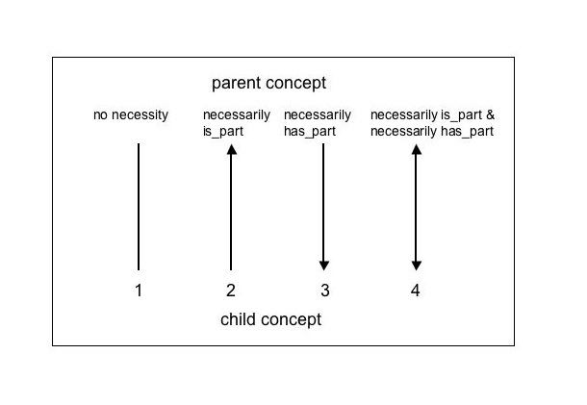
GO’s new definition of part-of
There are four basic levels of restriction for a part_of relationship:

Slide 79
New definition of part-of
The first type has no restrictions. That is, no inferences can be made from the relationship between parent and child other than that the parent may or may not have the child as a part, and the the child may or may not be a part of the parent.
The second type, 'necessarily is_part', means that wherever the child exists, it is as part of the parent: 'replication fork' is part_of 'chromosome', so whenever 'replication fork' occurs, it is as part_of 'chromosome', but 'chromosome' does not necessarily have part 'replication fork'.

Slide 80
Type three, 'necessarily is_part', is the exact inverse of type two …
The final type is a combination of both three and four, 'has_part' and 'is_part'.

Slide 81
part-of = is necessarily part of
The part_of relationship used in GO is usually type two, 'necessarily is_part'. Note that part_of types 1 and 3 are not used in GO
replication fork part-of cell,
but a replication fork is part of the cell only during certain times of the cell cycle

Slide 82
Official new definition of part-of
term: part_of
definition: Used for representing partonomies.

Slide 83
Official definition
term: derived_from
definition: Any kind of temporal relationship,
such as derived_from, translated_from

Slide 84
Problems with GO’s definitions
GO:0003673: cell fate commitment
Definition: The commitment of cells to specific cell fates and their capacity to differentiate into particular kinds of cells.
x is a cell fate commitment =def
x is a cell fate commitment and p

Slide 85
Genbank
a gene is a DNA region of biological interest with a name and that carries a genetic trait or phenotype

Slide 86
GO’s three ontologies are separate
molecular functions
biological processes
No links or edges defined between them
cellular components

Slide 87
Occurrents
Both molecular function and biological process terms refer to occurrents
= entities which do not endure through time but rather unfold themselves in successive temporal phases.
Occurrents can be segmented into parts along the temporal dimension.
Continuants exist in toto in every instant at which they exist at all.

Slide 88
Three granularities:
Molecular (for ‘functions’)
Cellular (for components)
Whole organism (for processes)

Slide 89
GO does not include molecules or organisms within any of its three ontologies
The only continuant entities within the scope of GO are cellular components (including cells themselves)

Slide 90
Are the relations between functions and processes a matter of granularity?
Molecular activities are the building blocks of biological processes ?
But they cannot be represented in GO as parts of biological processes

Slide 91
GO does not recognize parthood relations between entities on its three distinct levels of granularity
Compare:
this wheel is part of the car
this molecule is part of the car

Slide 92
Functions
‘The functions of a gene product are the jobs it does or the “abilities” it has’

Slide 93
Functions
chaperone activity motor activity catalytic activity signal transducer activity structural molecule activity transporter activity binding antioxidant activity | chaperone regulator activity enzyme regulator activity transcription regulator activity triplet codon-amino acid adaptor activity translation regulator activity nutrient reservoir activity

Slide 94
Appending function terms with ‘activity’
In 2003 all GO molecular function terms were appended … with the word 'activity'.
structural constituent of bone
structural constituent of cuticle
structural constituent of cytoskeleton
structural constituent of epidermis
structural constituent of eye lens
structural constituent of muscle
structural constituent of nuclear pore
structural constituent of ribosome
structural constituent of tooth enamel

Slide 95
terms appended with ‘activity’ …
because GO molecular functions are what philosophers would call 'occurrents', meaning events, processes or activities, rather than 'continuants' which are entities e.g. organisms, cells, or chromosomes. The word activity helps distinguish between the protein and the activity of that protein, for example, nuclease and nuclease activity.
In fact, a molecular 'function' is distinct from a molecular 'activity'. A function is the potential to perform an activity, whereas an activity is the realisation, the occurrence of that function; so in fact, 'molecular function' might more properly be renamed 'molecular activity'. However, for reasons of consistency and stability, the string 'molecular function' endures.

Slide 97
Part Two
Extending GO to make a full ontology

Slide 98
toxin transporter activity
Definition: Enables the directed movement of a toxin into, out of, within or between cells. A toxin is a poisonous compound (typically a protein) that is produced by cells or organisms and that can cause disease when introduced into the body or tissues of an organism.

Slide 99
Some formal ontology
Components are independent continuants
Functions are dependent continuants
(the function of an object exists continuously in time, just like the object which has the function;
and it exists even when it is not being exercised)
Processes are (dependent) occurrents

Slide 100
GO must be linked with other, neighboring ontologies
GO has: adult walking behavior but not adult
GO has: eye pigmentation but not eye
GO has: response to blue light but not light (or blue)
94% of words used in GO terms are not GO terms

Slide 101
Principle of Dependence
If an ontology recognizes a dependent entity then it (or a linked ontology) should recognize also the relevant class of bearers

Slide 102
Linking to external ontologies
can also help to link together GO’s own three separate parts

Slide 103
GO’s three ontologies
biological processes
molecular functions
← dependent →
cellular components
← independent

Slide 104
GO’s three ontologies
cellular
processes
organism-level
biological processes
molecular functions
cellular components

Slide 105
molecular functions
cellular
processes
organism-level
biological processes
molecule
complexes
cellular components
organisms
‘part-of’; ‘is dependent on’

Slide 106
part-of:
is dependent on:

Slide 107
molecular functions
cellular
processes
organism-level
biological processes
molecule
complexes
cellular components
organisms

Slide 108
molecular processes
cellular
processes
organism-level
biological processes
molecular functions
cellular
functions
organism-level
biological functions
molecule
complexes
cellular components
organisms

Slide 109
molecular processes
cellular
processes
organism-level
biological processes
functionings
functionings
functionings
molecular functions
cellular
functions
organism-level
biological functions
molecule
complexes
cellular components
organisms

Slide 110
molecular processes
cellular
processes
organism-level
biological processes
functionings
functionings
functionings
molecular functions
cellular
functions
organism-level
biological functions
molecule
complexes
cellular components
organisms
molecular
locations
cellular locations
organism-level
locations

Slide 111
Human beings know what ‘walking’ means
Human beings know that adults are older than embryos
GO needs to be linked to ontology of development
and in general to resources for reasoning about time and change
space and shape
growth and motion
contact and connectedness …

Slide 112
but such linkages are possible
only if GO itself has a coherent formal architecture

Slide 114
Is this all just philosophy ?

Slide 115
Human consequences of inconsistent and/or indeterminate use of operators such as ‘/ ’
29% of GO’s contain one or more problematic syntactic operators
but these terms are used in only 14% of annotations
Hypothesis: reflects the fact that poorly defined operators are not well understood by annotators, who thus avoid the corresponding terms

Slide 116
Computational consequences of inconsistent and/or indeterminate use of operators
The information captured by GO through its use of problematic syntactic operators is not available for purposes of information retrieval

Slide 117
Problems caused by GO’s formal incoherence
1. Coding errors → constant updating
2. Need for expert knowledge (which computers do not have access to)
3. Obstacles to ontology integration

Slide 118
Problems caused by GO’s formal incoherence
4. It is unclear what kinds of reasoning are permissible on the basis of GO’s hierarchies.
5. The rationale of GO’s subclassifications is unclear.
6. No procedures are offered by which GO can be validated.

Slide 119
Quality assurance and ontology maintenance must be automated
As GO increases in size and scope it will “be increasingly difficult to maintain the semantic consistency we desire without software tools that perform consistency checks and controlled updates”

Slide 120
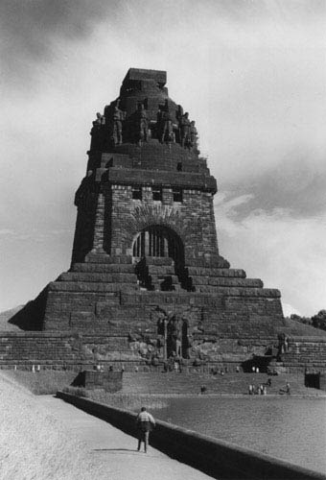

The End

